Slide 1
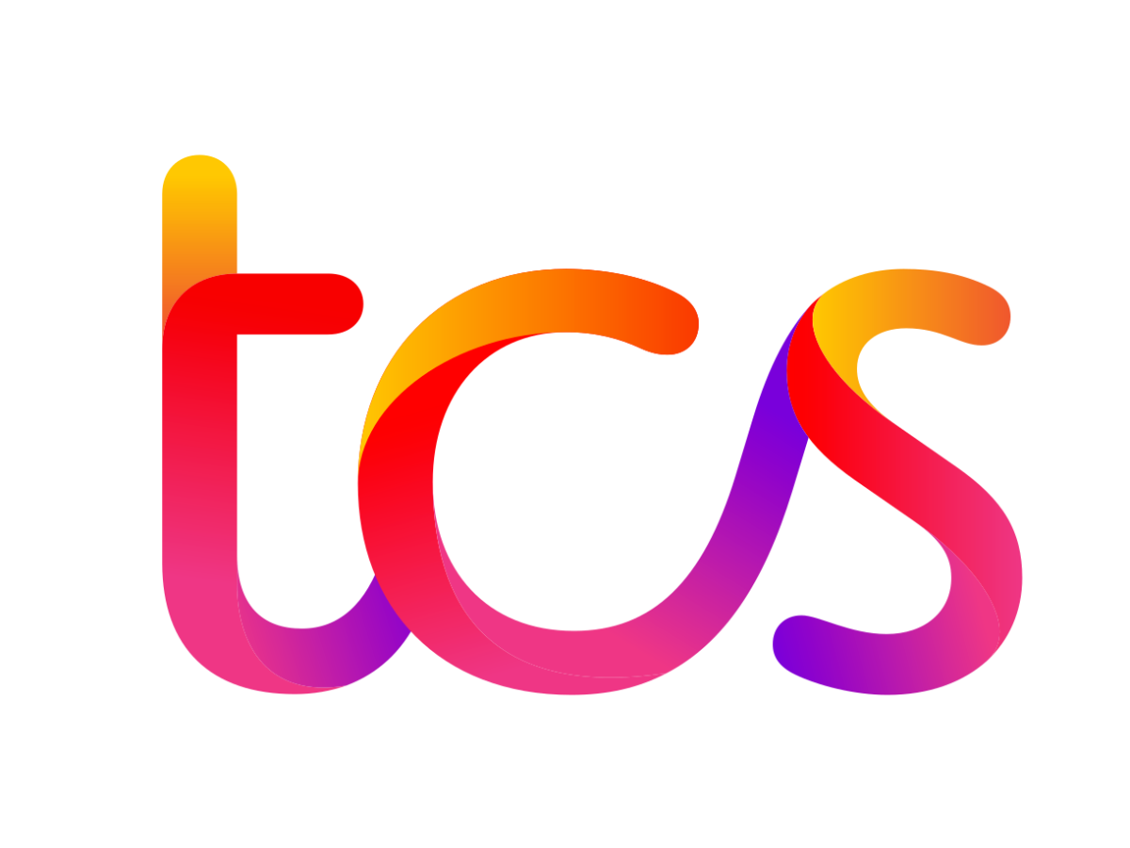
TATA CONSULTANCY SERVICES

Slide 2

ABOUT THE COMPANY
Tata Consultancy Services (TCS) is an Indian multinational information technology (IT) services and consulting company headquartered in Mumbai, Maharashtra. It is a part of the Tata Group, India's largest multinational business group. TCS is the world's second-largest IT services employer and the largest private-sector employer in India. It has over 614,000 employees in 55 countries. TCS provides a wide range of IT services and solutions to clients in various industries, including banking and financial services, insurance, manufacturing, retail, healthcare, telecommunications, and media and entertainment. TCS was founded in 1968 as a division of Tata Sons, the holding company of the Tata Group. In 1995, TCS became a separate company and was listed on the Bombay Stock Exchange and the National Stock Exchange of India. TCS is a leading provider of IT services and solutions, and it has been recognized for its innovation and customer focus. It has won numerous awards, including the Global Outsourcing 100 by IAOP, the Fortune India 500, and the Forbes Global 2000. TCS is also committed to sustainability and social responsibility. It has been ranked among the world's most sustainable companies by the Dow Jones Sustainability Index and the FTSE4Good Emerging Index. TCS also supports various community development programs in India and around the world. TCS plays a significant role in the Indian economy. It is one of the country's largest exporters and a major contributor to foreign exchange earnings. TCS also helps to create jobs and boost the growth of the IT sector in India.

Slide 3

OVERVIEW OF THE INDUSTRY
The IT industry in India is one of the fastest-growing and most important sectors of the economy. It contributes over 7% to India's GDP and employs over 5 million people. India is a global leader in IT services, accounting for over 50% of the global market. The Indian IT industry is characterized by its strong track record of innovation, its global reach, and its deep understanding of the needs of its clients. Indian IT companies are known for their high-quality services, competitive pricing, and efficient delivery. The Indian IT industry is also a major driver of economic growth and job creation. It has helped to create millions of jobs and has boosted the growth of the Indian economy.
The rise of cloud computing: Cloud computing is rapidly transforming the way businesses consume IT services. Indian IT companies are leading providers of cloud computing services, and they are helping their clients to migrate to the cloud and benefit from the cost savings, scalability, and flexibility that cloud computing offers.
The growth of data analytics and artificial intelligence: Data analytics and artificial intelligence are two of the most important technological trends of our time. Indian IT companies are helping their clients to harness the power of data analytics and AI to improve their operations, make better decisions, and create new products and services.
The rise of digital transformation: Digital transformation is the process of using technology to transform business models and processes. Indian IT companies are helping their clients to embrace digital transformation and become more competitive in the digital age.

Slide 4

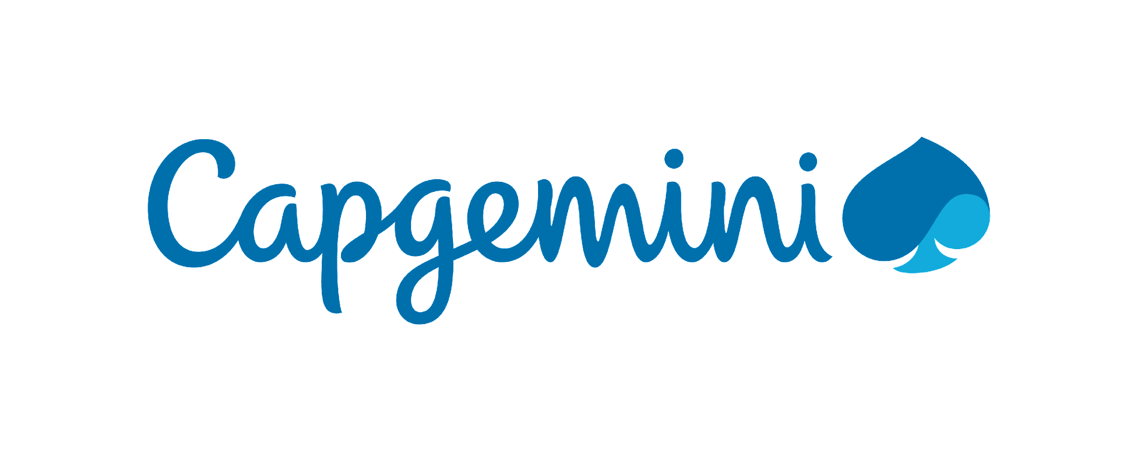

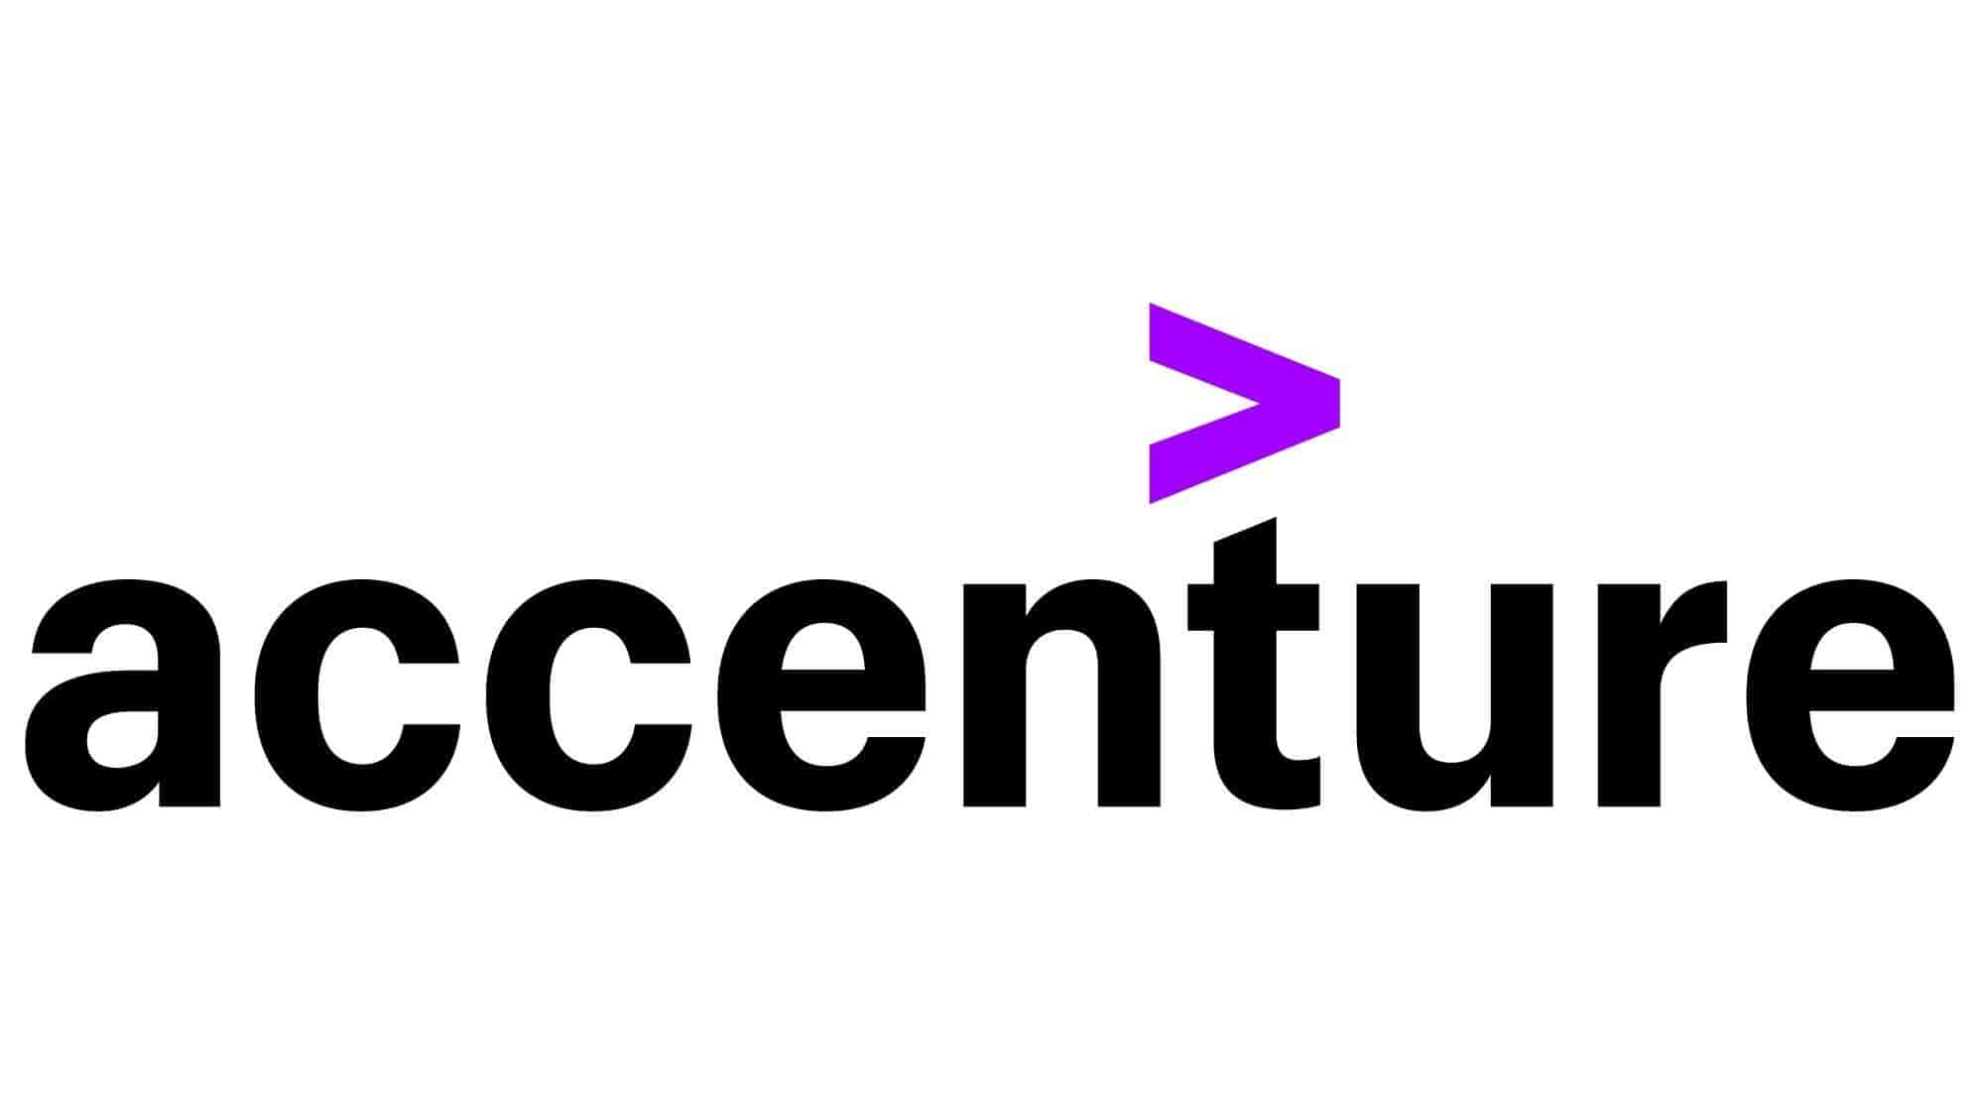
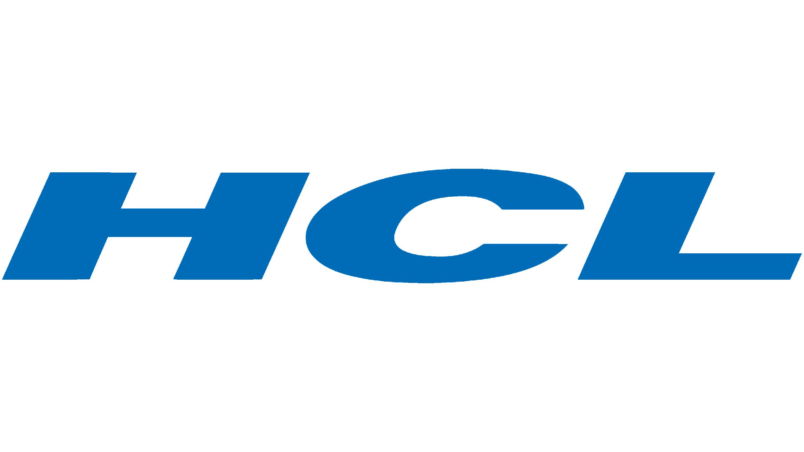

COMPETITORS

Slide 5
LIQUIDITY RATIOS
Current Ratio checks the ability of the firm to pay its current liabilities in time, these ratios are used to assess the short-term financial position of a firm.
Quick Ratio also known as the acid-test ratio, is a stricter test of liquidity than the current ratio. It is calculated by dividing the sum of cash, marketable securities, and accounts receivable by total current liabilities.
Cash Ratio is a liquidity measure that shows a company's ability to cover its short-term obligations using only cash and cash equivalents.
All three liquidity ratios indicate a company's ability to meet its short-term debt obligations. A higher liquidity ratio indicates that a company is more likely to be able to meet its short-term debt obligations, while a lower liquidity ratio indicates that a company is more likely to have difficulty meeting its short-term debt obligations.

Slide 6
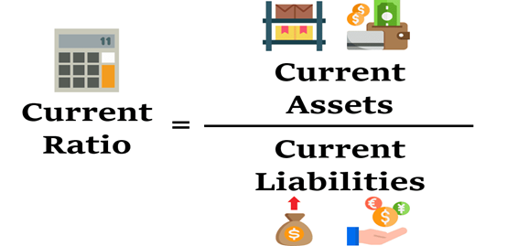
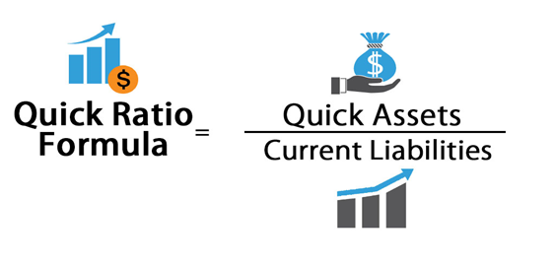
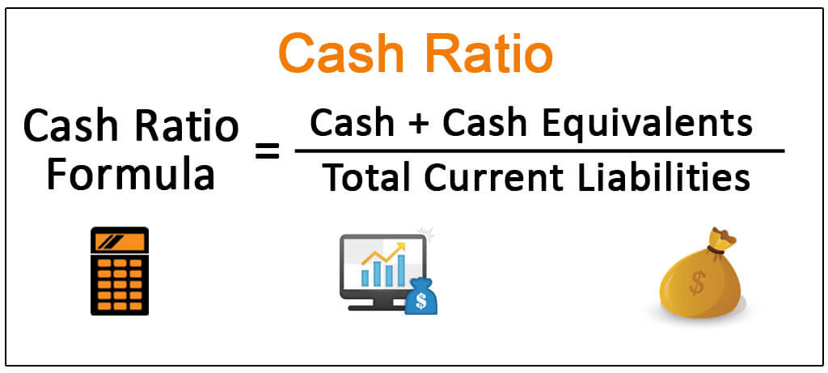
LIQUIDITY RATIOS | 2022 | 2023 | % Change
Current Ratio | 2.49 | 2.36 | -0.052
Quick Ratio | 2.48 | 2.36 | -0.053
Cash Ratio | 0.36 | 0.12 | -0.67
 | 2023 | 2022
Net Sales | 1,90,354 | 1,60,341
Total Receivables | 43119 | 36245
Receivables / Sales | 0.226 | 0.226

Slide 7
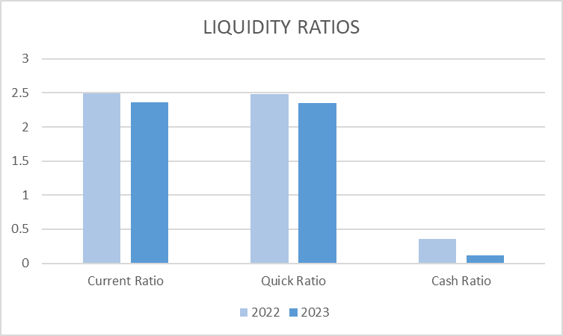
The firm is able to meet its short-term obligations out of its short-term resources, as it has a current ratio of more than 1, i.e., 2.36, which means that for every 1 unit of current liability it has 2.36 units of current assets.
The Quick Ratio of the company is extremely similar as the Current Ratio as the company has negligible inventory, being a service providing company.
The Cash Ratio of the company has reduced compared to last year as the cash equivalent of the company has significantly reduced along with a slight increase in the current liabilities.
We can say that Receivables move in line with Sales as there is not much difference in the above-mentioned percentages. Also, there has not been much significant change in trade receivables as it has only increased from 566 to 733 crores this year.

Slide 8

PROFITABILITY RATIOS
Gross Profit ratio is a profitability ratio that shows the relationship between gross profit and net revenue
Net Profit Ratio indicates the overall efficiency of the business.
Operating Profit Ratio determines the operational efficiency of the management.
Return on capital employed (ROCE) is a financial ratio companies use to gauge their performance. ROCE is an indicator of a company's efficiency because it measures the company's profitability after factoring in the capital used to achieve that profitability.
Return on Net Worth measures how much equity shareholders of the firm get on their investments.

Slide 9
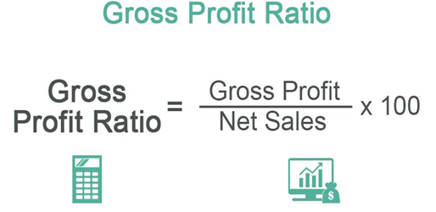
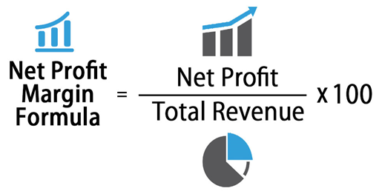
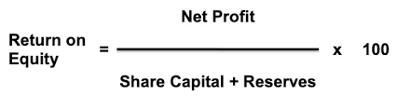
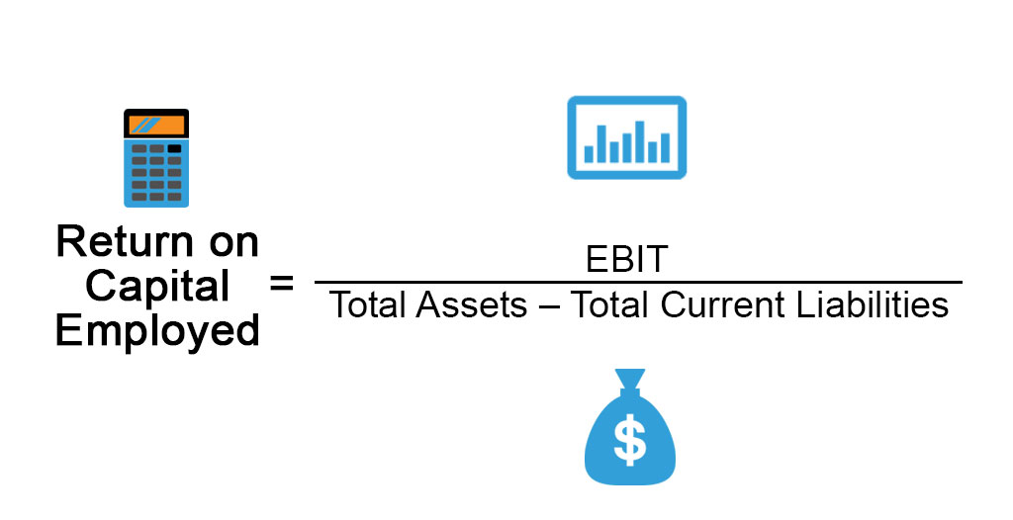
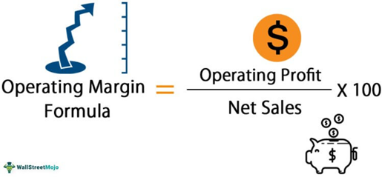
PROFITABILITY RATIOS | 2023 | 2022 | % change
Gross Profit Margin | 27.15 | 31.01 | -0.12
Net Profit Margin | 20.54 | 23.81 | -0.13
Operating Profit Margin | 27.51 | 31.31 | -0.12
Return on Capital Employed | 65.07 | 60.23 | 0.08
Return on Net Worth | 52.46 | 49.48 | 0.06

Slide 10
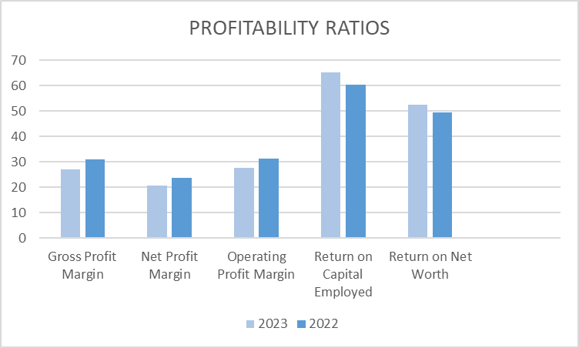
The net profit ratio of the company decreased from 23.81% in 2022 to 20.54% in 2023 because the % change in Net Sales is more than the %change in Net Profit.
The Operating Profit Margin of the company has decreased from 31.31% to 27.51% mainly due to higher increase in Net sales compared to Operating profit.
The EBIT has increased from Rs. 50209cr in 2022 to Rs. 52385cr in 2023, which is a clear indicator that the firms seems to improve its Operational Profit but the decrease in operating profit margin shows that the company is having more operating expenses as compared to the previous year.

Slide 11
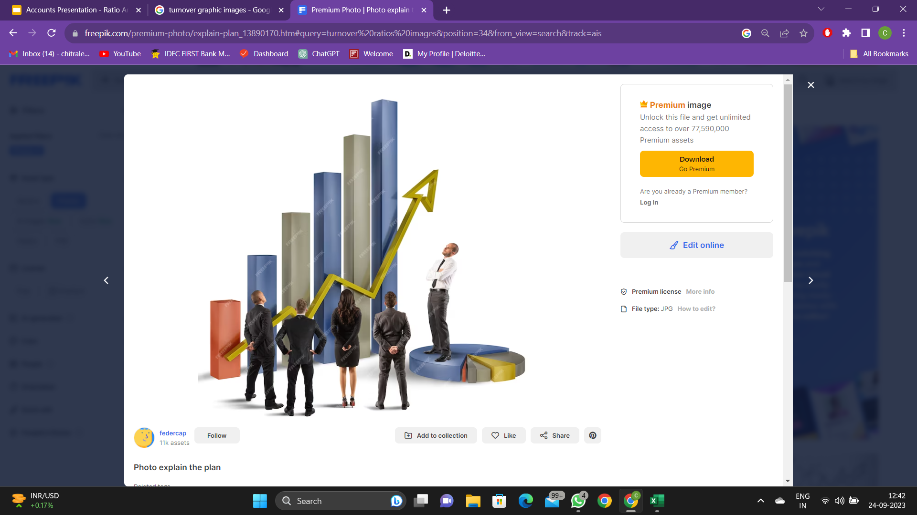

TURNOVER RATIOS (or) ACTIVITY RATIOS
Trade Receivable Turnover Ratio indicates the efficiency in the collection of amounts due from Trade Receivables. It measures the efficiency of trade receivables which is how efficient a firm is in converting its trade receivables into cash.
Trade Payable Turnover Ratio indicates the efficiency with which creditors are managed and paid.
Inventory Turnover Ratio measures how fast the stock is moving and generating sales.
Asset Turnover Ratio measures how efficient the firm is in generating sales from fixed assets.
Working capital turnover ratio is useful in assessing a company's liquidity and operational efficiency. A working capital ratio below one suggests that a company may be unable to pay its short-term debts.

Slide 12
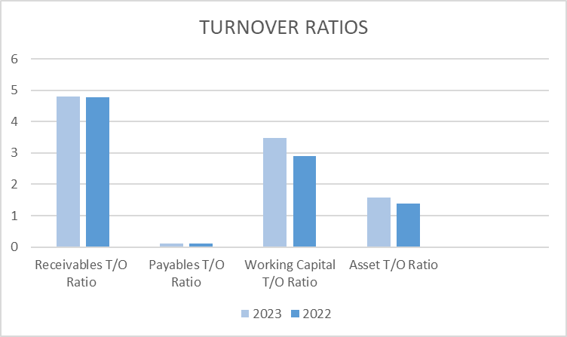
TURNOVER RATIOS | 2023 | 2022 | % change
Receivables T/O Ratio | 4.80 | 4.77 | 0.006
Payables T/O Ratio | 0.12 | 0.11 | 0.09
Working Capital T/O Ratio | 3.47 | 2.89 | 0.2
Asset T/O Ratio | 1.58 | 1.39 | 0.137
Inventory T/O Ratio | 0 | 0 | 0
Current Asset T/O Ratio | 2.05 | 1.70 | 20.59

Slide 13
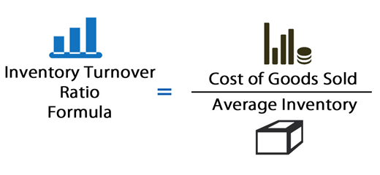
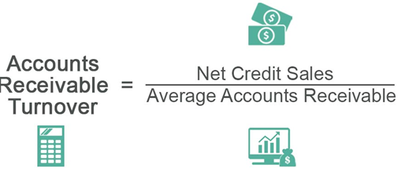
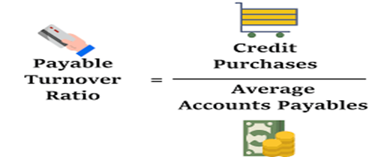
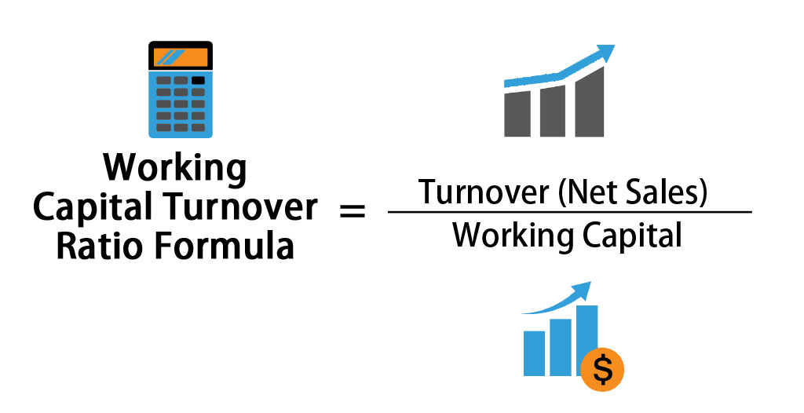
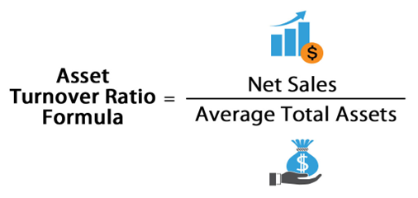
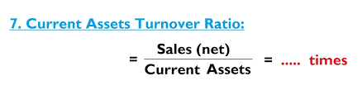

Slide 14
As per the above information, the Receivables T/O Ratio has remained the same around 4.8, representing that the company is taking the same time to convert its trade receivables into cash compared to last year.
The Payables T/O Ratio has also remained similar to what it was last year, ranging around 0.15 showing that the company is equally efficient in paying cash to the creditors with respect to last year and that the company is maintaining its cash position at the same level.
The Working Capital T/O Ratio has increased from 2.8 to 3.4 indicating that a company is able to generate a larger amount of sales compared to the past year and also demonstrates a healthier financial position and a better capacity to repay short-term liabilities with short-term assets.
The Asset T/O Ratio has slightly increased from 1.3 to 1.5 which indicates that the firm has increased its sales in 2023 by keeping the assets constant for both the years.
IT firms have an Inventory ratio of 0 since they do not offer tangible things. They instead sell services including software development, IT consulting, and managed IT services. Because these services are offered online, no inventory is required.
The Current Asset T/O ratio has shown an increase of 20.59% from 1.70 to 2.05.

Slide 15
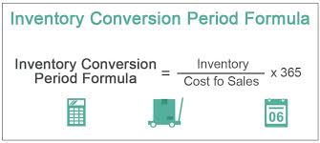
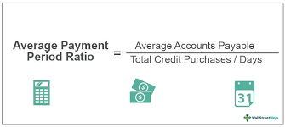
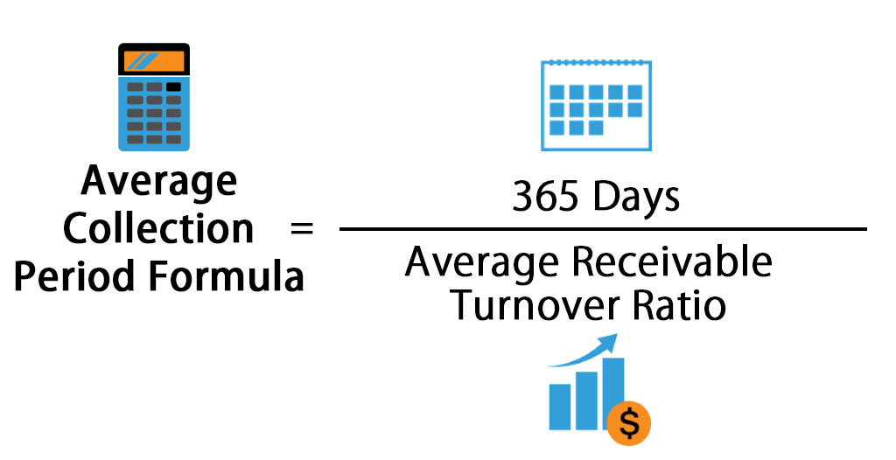
PERIOD | 2023 | 2022
Inventory holding period | 0 | 0
Collection period (Days) | 76 | 77
Payment period (Days) | 3074 | 3260
The Average Collection Period of the company has slightly reduced from 77 days to 76 days indicating a faster payment collection and slightly better liquidity.
The Average Payment Period of the company has decreased from 3260 days to 3074 days indicating faster payments made which indicate better relationship with the suppliers of the company but might affect the company’s overall liquidity.

Slide 16

SOLVENCY RATIOS
Debt equity ratio shows how much a debt a company has compared to its assets. A higher D/E ratio means the company may have a harder time covering its liabilities
Interest coverage ratio indicates how well a company can pay the interest on its outstanding debts

Slide 17
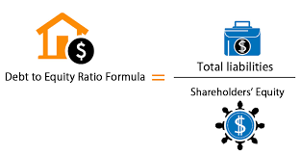
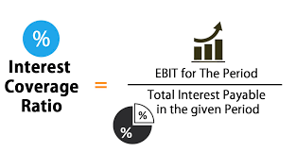
SOLVENCY RATIOS | 2023 | 2022 | % change
Debt equity ratio | 0.08 | 0.08 | 0
Interest coverage ratio | 75.37 | 103.3 | -0.27

Slide 18
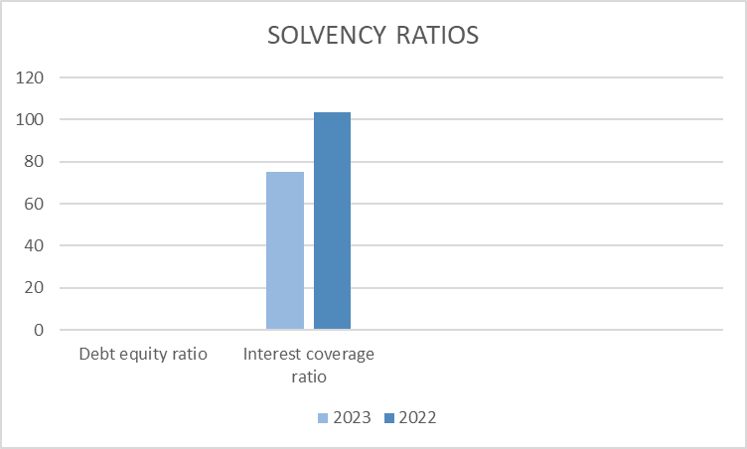
Debt equity ratio has remained the same of value 0.08 for both the years 2021-2022 and 2022-2023. This consistency in the debt-equity ratio indicates that the company’s equity increases in line with it’s long term debts.
Interest coverage ratio has decreased from 103.3 in the financial year 2021-2022 to 75.37 in the financial year 2022-2023. This shows that the company’s ability to pay interest on time is reduced compared to the previous year.

Slide 19

INVESTOR RATIOS
Earnings per share - EPS indicates how much money a company makes for each share of its stock and is a widely used metric for estimating corporate value.
Price to Earnings Ratio or Price to Earnings Multiple indicates whether a stock at its current market is expensive or cheap
Dividend Yield measures the quantum of earnings by way of total dividends that investors make by investing in that company.
Dividend Payout Ratio measures the dividends paid out to shareholders relative to the companies net income. It indicates how much a company pays out in dividends each year relative to its stock price

Slide 20
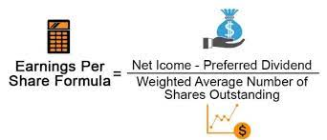
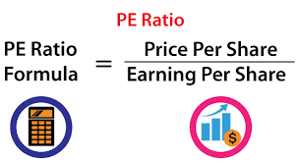
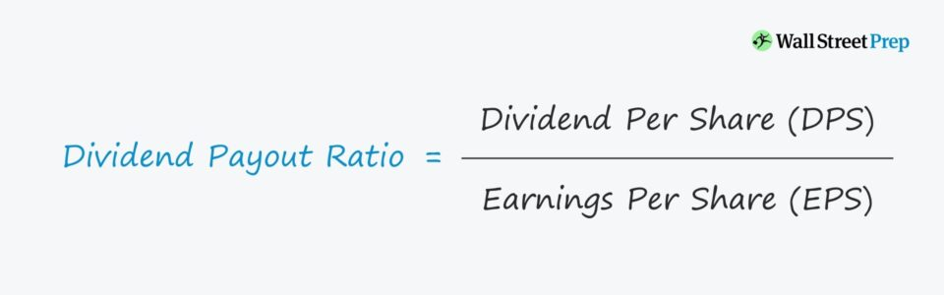
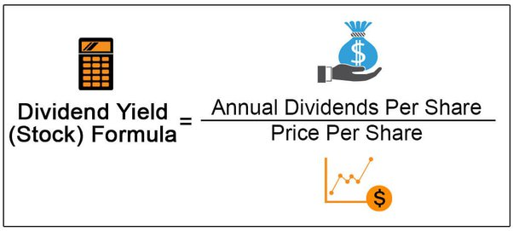
INVESTOR RATIOS | 2023 | 2022 | % change
Earnings Per Share | 106.84 | 103.2 | 0.03
Price to Earnings Ratio | 30 | 32.53 | -0.07
Dividend Yield | 3.18 | 1.33 | 1.39
Dividend payout ratio | 107 | 42 | 154

Slide 21
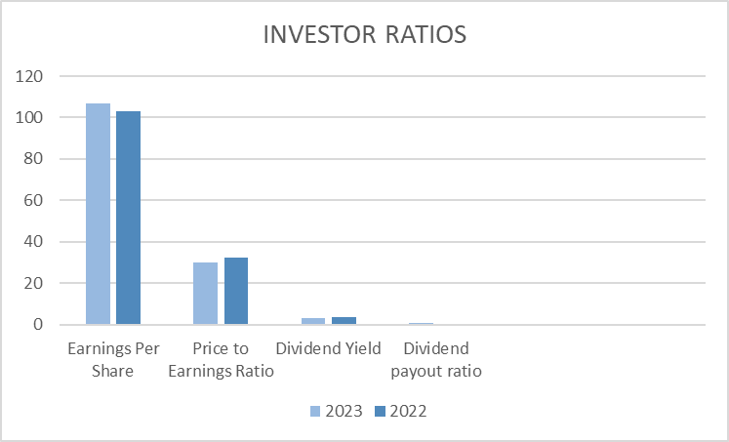
The Earnings Per Share has increased from 103.20 to 106.84 which means that the company is profitable enough to pay out more money to its shareholders.
The P/E Ratio has decreased from 32.53 to 30 which means that a stock is cheap and its price may rise in the future.
The increase in the dividend yield from 1.33 to 3.18 indicates that the dividend paid with respect to the price of the stock has gone up.
The increase in dividend payout ratio from 42 to 107 shows that the company pays more dividend than the profit it earns, which might show negative effects on the sustainability.

Slide 22
COMPETITOR ANALYSIS
The liquidity of the company is slightly better than its competitor Tech Mahindra as of 2023.
The actual cash liquidity of the company, which was better in 2022 compared to its competitor has decreased in the following year and is almost equal as of 2023.
The Net Profit Margin of TCS is significantly higher than its competitor which indicates that the company has performed well.
The debt-equity ratio of TCS is higher than its competitors which indicates that the company runs most of its daily operations through debts, which might be a negative factor.
The EPS of TCS is significantly higher than its competitor Tech Mahindra indicating that the company is highly profitable.
2022 | TCS | TECH MAHINDRA
CURRENT RATIO | 2.49 | 2.60
CASH RATIO | 0.36 | 0.20
NET PROFIT MARGIN | 23.81 | 14.04
DEBT EQUITY RATIO | 0.08 | 0.015
EPS | 103.2 | 51.61
2023 | TCS | TECH MAHINDRA
CURRENT RATIO | 2.36 | 2.07
CASH RATIO | 0.12 | 0.14
NET PROFIT MARGIN | 20.54 | 8.85
DEBT EQUITY RATIO | 0.08 | 0.014
EPS | 106.84 | 38.68

Slide 23
CASH FLOW ANALYSIS
The company had cash and cash equivalents of ₹1,462 crore at the end of the year 2023. This is a significant decrease from ₹8,197 crore at the beginning of the year.
The net change in cash and cash equivalents for the year ended March 31, 2023, was negative at -₹6,945 crore. This indicates that the company used more cash than it generated during the year.
The primary sources of cash for the firm in the year ended March 31, 2023, were its core operating activities and the proceeds from the sale or redemption of investments. These sources contributed to the firm's positive cash flow from operating and investing activities.
The firm appears to fund its capital expenditures through a combination of internal cash generation, proceeds from the sale of investments, and potentially other sources of financing.
It appears that the firm paid out more in dividends (₹41,347 crore) than it earned in net profit (₹39,106 crore) in the year ended March 31, 2023.
The net profit is higher than the cash flow from operating activities. Specifically, the net profit exceeds the cash generated from operations by ₹2,077 crore.
YEAR | Net Cash Generated from operating activities
2022 | 36127
2023 | 37029
YEAR | Net Cash flow from investing activities
2022 | 3642
2023 | 3250
YEAR | Net cash used in Financing Activities
2022 | -32797
2023 | -47224
YEAR | Net change in cash and cash equivalents
2022 | 6972
2023 | -6945

Slide 24
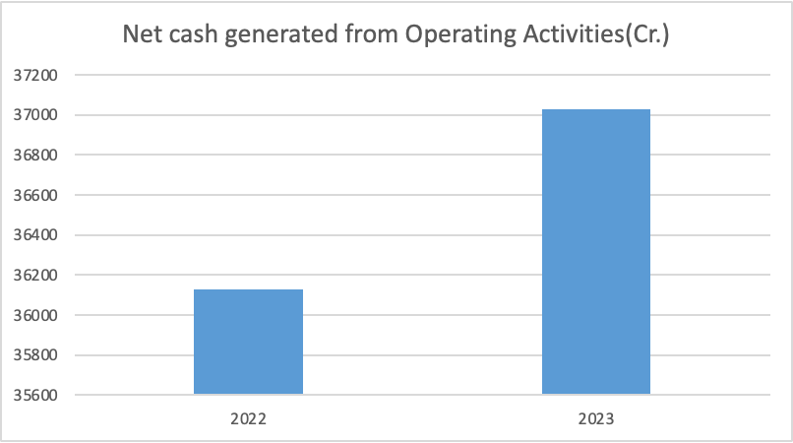
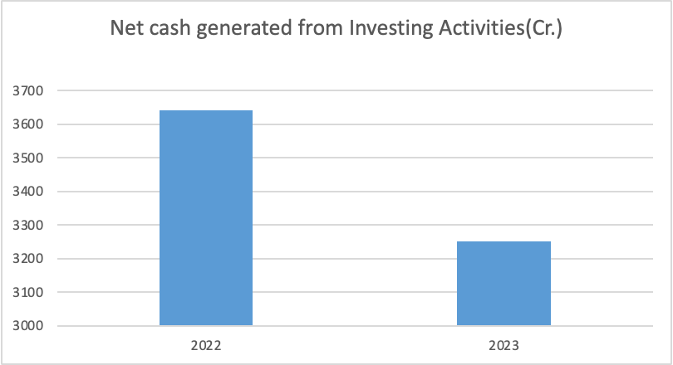
CONCLUSION
Operating activities :The revenue has seen a growth of 2.496%. The company has shown an increase in operating profit/ EBIT as compared to previous years.
Investing activities : There is a reduction in the net cash generated from Investing activities as compared to the previous year by 10.76%. The company made significantly more investments in the year 2023.

Slide 25
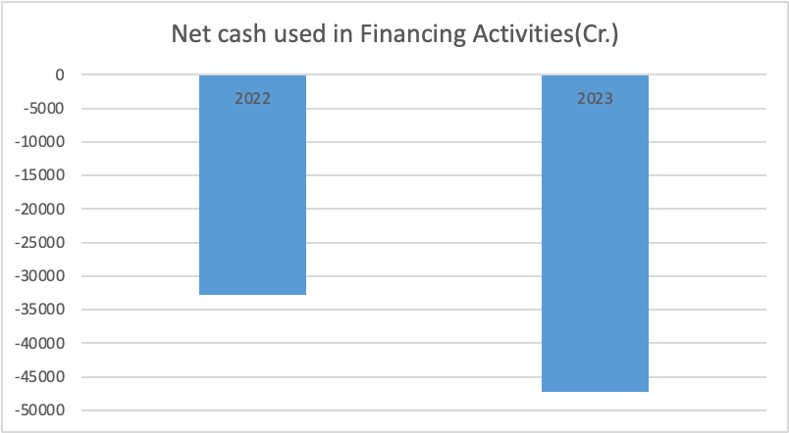
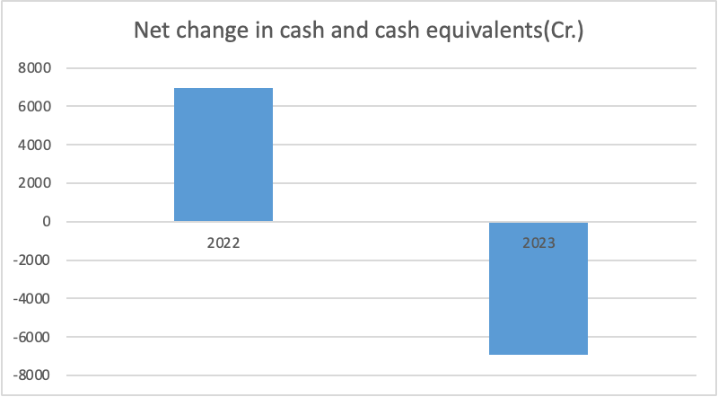
Financing activities : The statement indicates huge cash outflow for year 2023 as compared to 2022. It shows a 43.98% percentage change. One of the reason TCS has observed outflow in financing activities is because the company has paid excessive dividend in 2023 compared to the available net profit. Above that the firm even has seen an increase in amount of repayment of lease, interest paid.
Cash and Cash equivalents : The net change in cash and cash equivalents was negative (-₹6,945 crore) for the year, indicating that the firm used more cash than it generated overall. The percentage change in cash and cash equivalent at the end of the year as compared to that of the previous year is significant reduction by 82.16%.

Slide 26
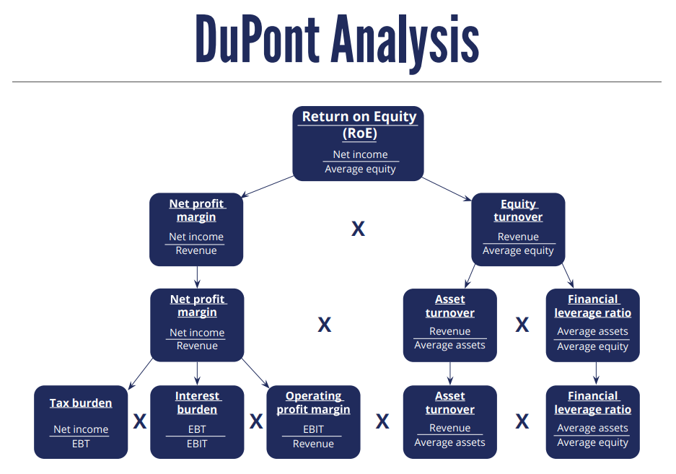

Slide 27
DuPont ANALYSIS
DuPont ANALYSIS |  | 2023 | 2022
Return on Equity |  | 52.46 | 49.48
Net Profit Margin | PAT/Net Sales | 20.54 | 23.81
Asset Turnover Ratio | Net Sales/Total Assets | 1.58 | 1.39
Equity Multiplier | Total Assets/Net worth | 1.6 | 1.57
Return on Total Asset | (PAT/Total Assets)*100 | 32.63 | 31.49
Operating Profit Ratio | PBIT/Net Sales | 27.51 | 31.31

Slide 28
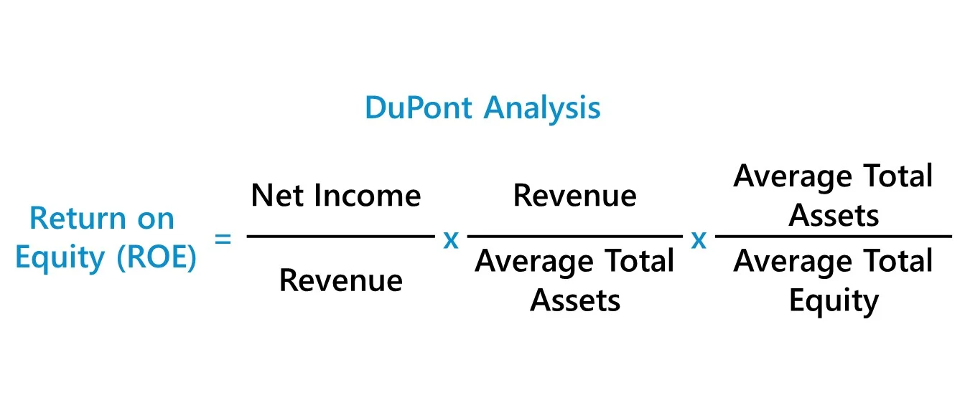
DuPont ANALYSIS
The dupont model helps us to determine the contribution of each factor to the change in Return on net worth. The return on net worth is increasing, this shows that the company is generating marginal profit per equity as compared to the previous year.
This change is mainly because of change in net profit ratio as the assets turnover ratio has increased and the increase in asset turnover ratio shows that the company is efficient in generating revenue from its assets.
There is not much change in leverage ratio which means average total assets and average net worth have increased in the same proportion.

Slide 29
ROA AND ROE OF THE INDUSTRY
 | TCS | INFOSYS | WIPRO | TECH MAHINDRA
ROE - 2023 | 52.46 | 34.34 | 14.62 | 15.21
ROE - 2022 | 49.48 | 30.63 | 22.32 | 19.00
ROA - 2023 | 32.63 | 22.96 | 10.75 | 10.48
ROA - 2022 | 31.49 | 21.36 | 15.09 | 14.03
The ROE indicates that the company is generating better revenues from the earnings it has successfully retained compared to its competitors for the past 2 years.
The ROA indicates that the company has utilised its assets in a much better and efficient manner compared to its competitors for the past 2 years.

Slide 30
CONTRIBUTIONS AND LIMITATIONS OF THE STUDY
Contributions :
Assists in calculation and analysis of the performance of the firm.
Upcoming trends and patterns can be predicted.
Limitations :
It is more of a quantitative approach rather than a qualitative approach.
Competition in this segment is intense and comparisons between firms and years maybe meaningless due to differences in accounting procedures between years or companies.
It does not take human capital into account while calculation.
Forecasting becomes the difficult job as through ratio analysis is done on the basis of historical data.

Slide 31
